Slide 1
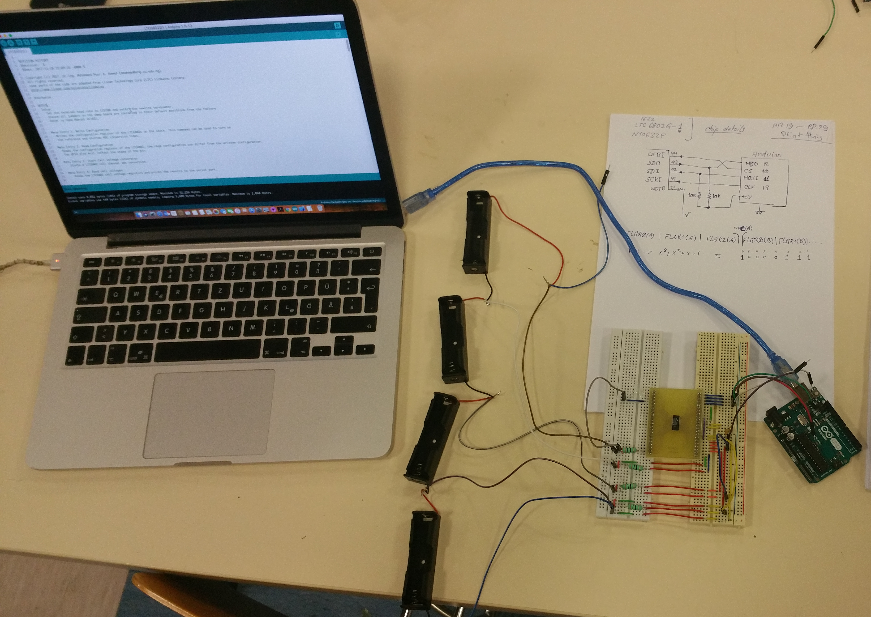
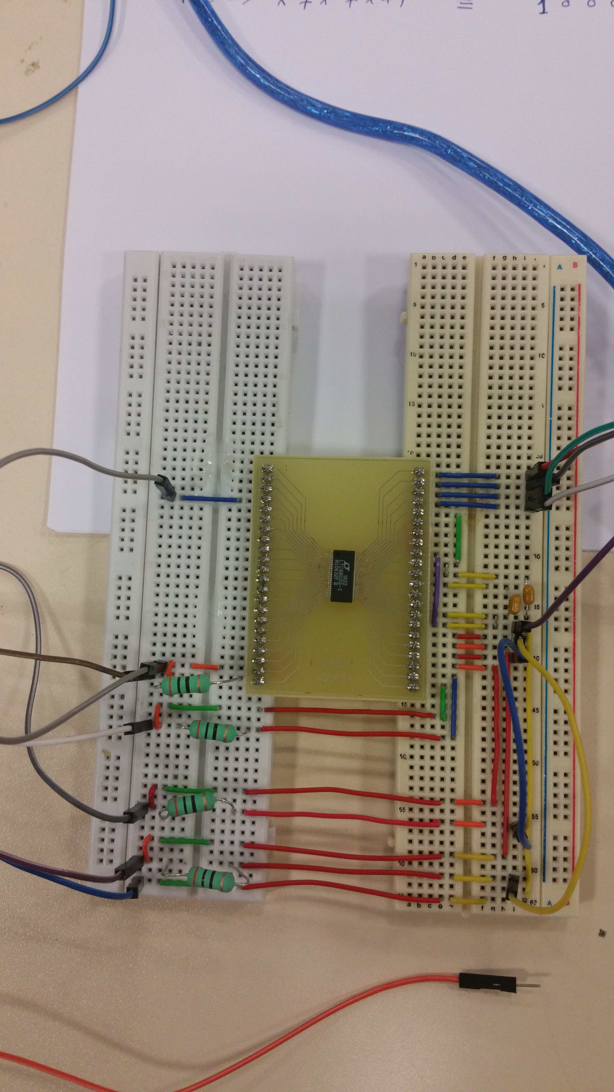
Multicell Battery Monitor Based on LTC6802G-1 Chip
Software Architecture
Hardware
Arduino Hardware & Driver Sketch
SPI Communication API
User Interface
LTC6802G-1 API
Remote (IoT/Android)
User Interface
Copyright©2017 Asst.Prof.Dr.Ing. Mohammed Nour A. Ahmed. All Rights Reserved. | mnahmed@eng.zu.edu.eg | https://mnourgwad.github.io

